Slide 1


Zomato Analysis

Slide 2
Index
Overview
Objectives
Data Model
KPIs And Insights
Dashboard
Recommendation And Implications

Slide 3
Overview of Project
By analyzing data obtained from sources, the project aims to provide actionable recommendations for improving Zomato's services, enhancing user experience, and optimizing business strategies.

Slide 4
Objectives
The primary goal of the Zomato Analysis Project is to gain insights into Zomato's performance, user preferences.
Understand the User Behaviour
Improve User Experience
Gain Insights based on Cities And Countries
Gain Insights based on Year, Month, Quarter as well as based on Average Ratings And Average Price.
Monitor performance, track trends, and make data-driven decisions effectively.

Slide 5
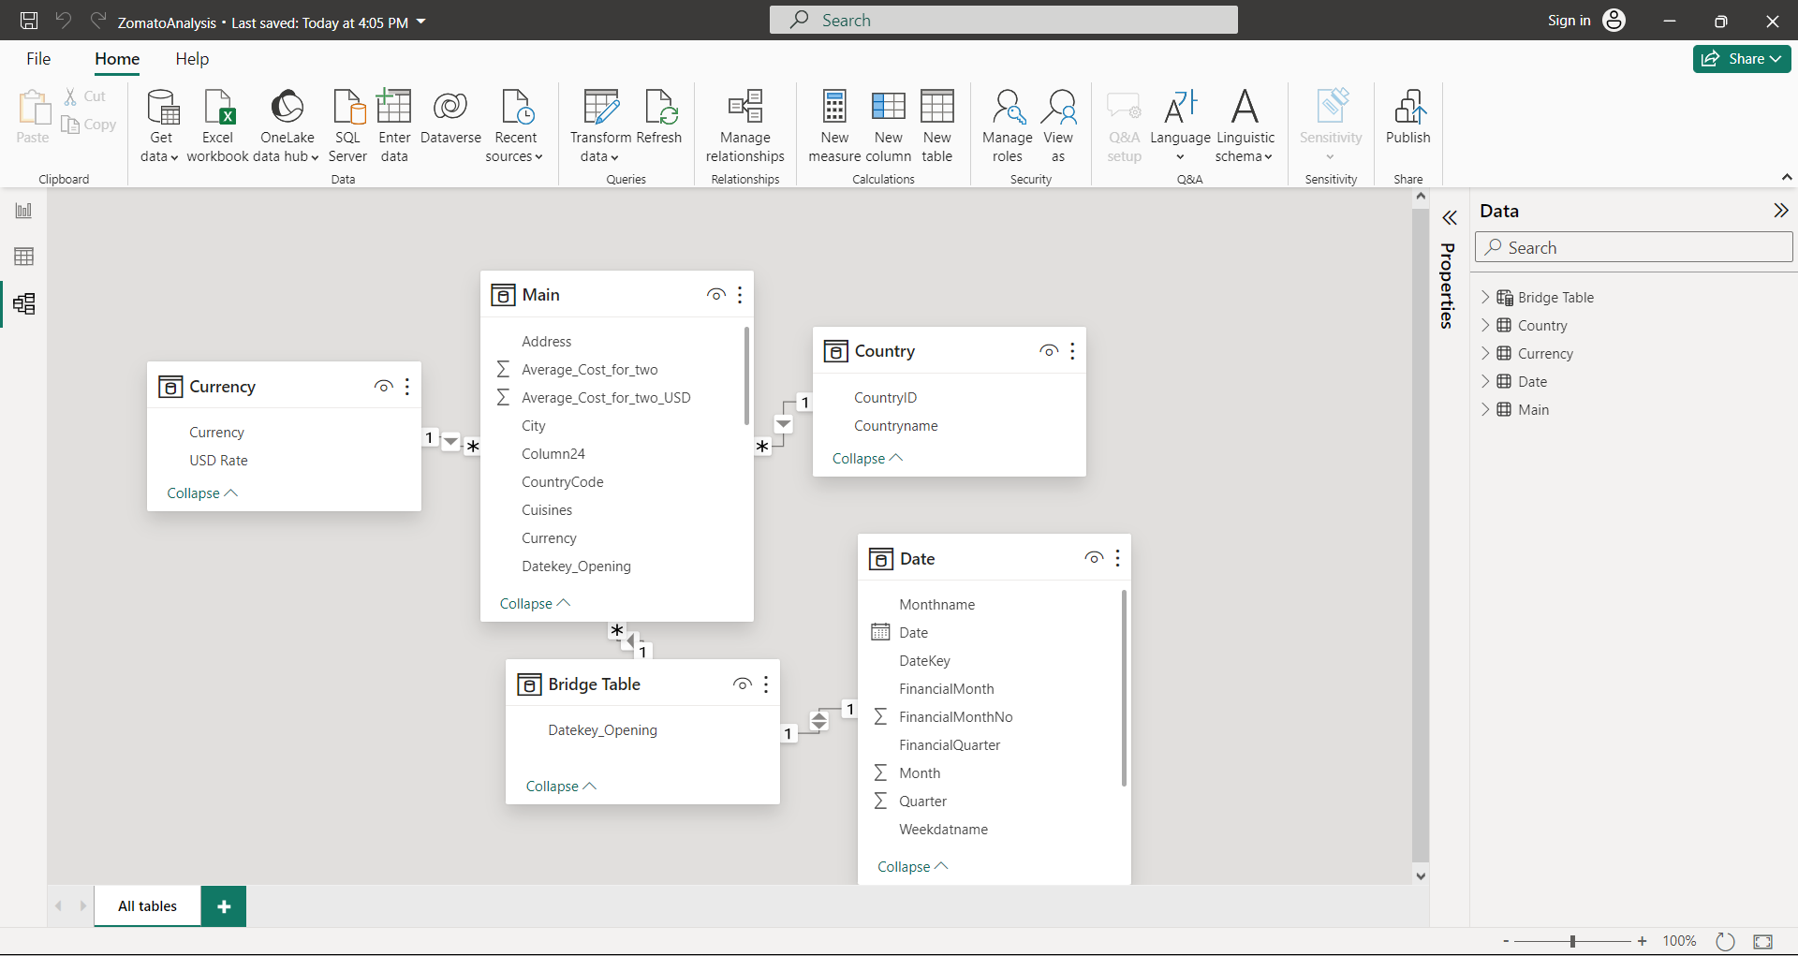
Data Model

Slide 6
1st KPI And Insights
Restaurants Based on City And Country
It shows India has considerably high number of restaurants.
New Delhi, Noida and Gurgaon being top 3 cities
Allocate marketing resource to these areas for maximizing potential revenue.

Slide 7
2nd KPI And Insights
Numbers of Restaurants opening based on Year , Quarter , Month
Analysing the patterns of restaurant openings by year, quarter, and month. We can say that we need to maintain steady supply to the restaurants throughout the year for proper functioning.

Slide 8
3rd KPI And Insights
Count of Restaurants based on Average Ratings
Organization should focus on improving the customer satisfaction from restaurants having rating between 1 to 1.5 and try to convert it towards 3 to 3.5.
For Example: Improve the quality of food as well as customer service.

Slide 9
4th KPI And Insights
Create buckets based on Average Price of reasonable size and find out how many restaurants falls in each buckets
Restaurants offering relatively lower prices which means by giving frequent discounts based on amount of bill will increase the customer retention which will result in increase in profits.

Slide 10
5th and 6th KPI And Insights
Percentage of Restaurants based on "Has_Table_booking“ and Has_Online_Delivery
The percentage of restaurants in offering table booking services, to check the availability of reservation options in the industry
The percentage of restaurants offering online delivery services, highlighting the adoption of digital platforms in current world for food delivery.

Slide 11
Custom KPIs
Restaurants “Is_Delivering_Now”
By Analyzing data of “is_delivering_now” we are trying to show percentage of a considerable portion of Zomato restaurants are currently offering delivery services.

Slide 12
Custom KPIs
Restaurants Based on Ratings
The height of each bar corresponds to the number of restaurants receiving a particular rating. Higher bars indicate a greater number of restaurants with that rating.

Slide 13
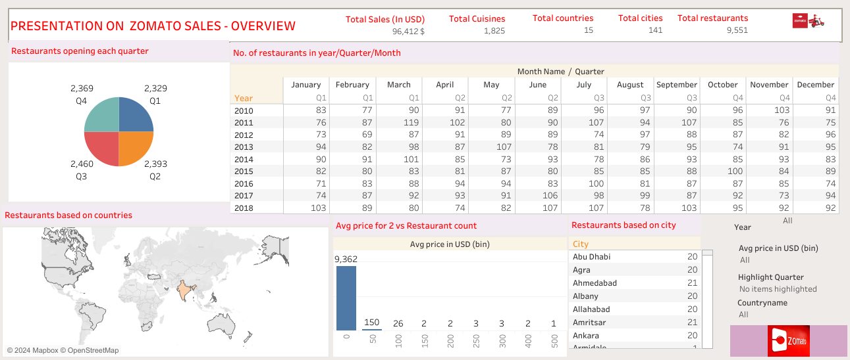
Dashboard

Slide 14
Recommendations And Implications
Identify cities and countries with the highest concentration of restaurants. Allocate marketing resource to these areas for maximizing revenue potential.
Based on the analysis, recommend strategic planning for peak opening periods.
Implement feedback mechanisms to continuously monitor and address customer concerns to maintain high satisfaction levels.
Consider adjusting menu offerings and value propositions based on price sensitivity within each segment.
Encourage restaurants to adopt table booking and online delivery services to meet evolving consumer preferences.
Encourage restaurants to focus on improving the quality and consistency of their food, service, and overall dining experience. Consistency is key to maintaining high ratings and building customer loyalty.
Encourage restaurants to actively monitor and respond to customer reviews on platforms like Zomato. Addressing both positive and negative feedback demonstrates responsiveness and a commitment to customer satisfaction.

Slide 15
Thank You!!!

